Slide 1
Active Learning Strategies DeepAL
Selected Topics in AI_2
T.a/ Salah

Slide 2
Team members:
Maymounah Abdulazeem – 20190657
Ali Adel Ali Ahmed - 20190337

Slide 3
Datasets:
Datasets:
MNIST dataset
CIFAR10 dataset
MNIST dataset with Unbalance

Slide 4
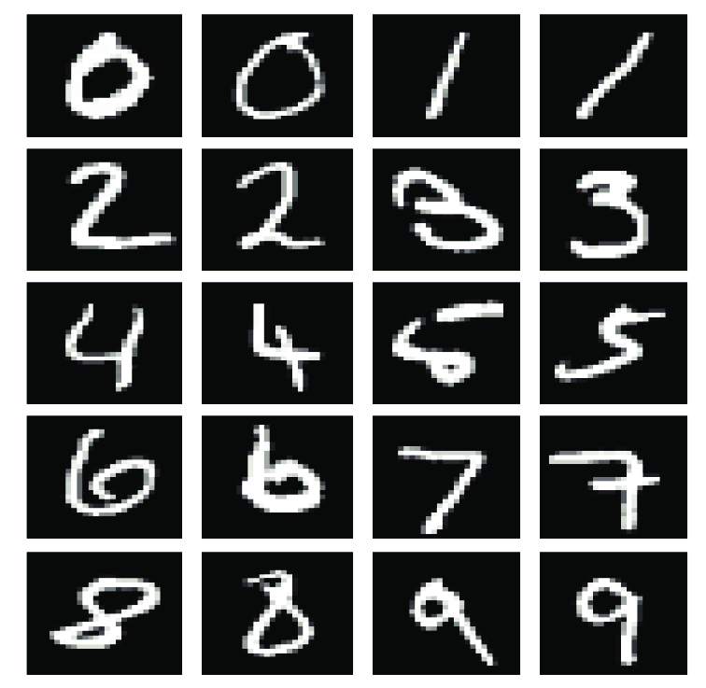
MNIST dataset:
The MNIST dataset contains 70,000 handwritten digits (0-9) that have been normalized and centered in a fixed-size image format of 28x28 pixels. The dataset is split into 60,000 training images and 10,000 test images. It is often used as a benchmark for image classification algorithms and is considered a relatively easy dataset to classify.

Slide 5
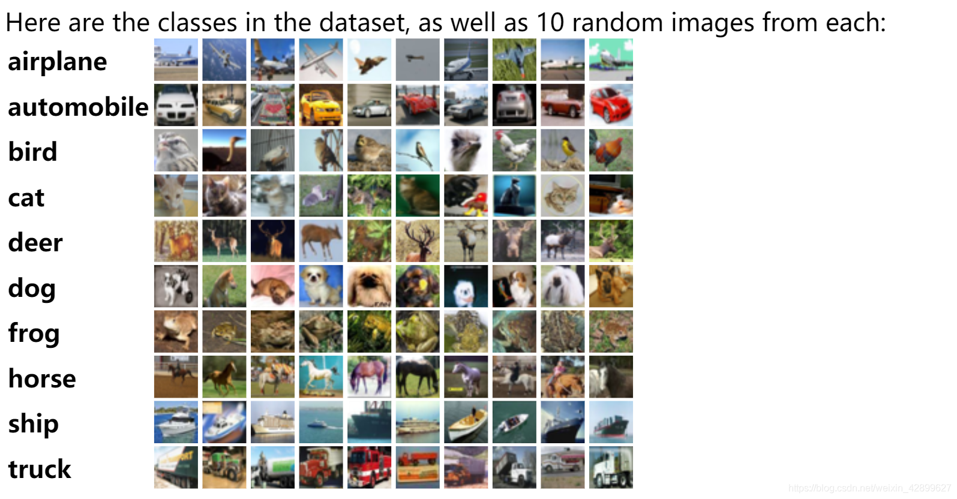
Cifar10 dataset:
The CIFAR-10 dataset consists of 60,000 color images in 10 classes, with 6,000 images per class. The images are 32x32 pixels in size, and each pixel is represented by three color channels (red, green, and blue). The dataset is split into 50,000 training images and 10,000 test images. The classes are mutually exclusive and include airplane, automobile, bird, cat, deer, dog, frog, horse, ship, and truck.

Slide 6
MNIST Dataset with Unbalanced:
An unbalanced dataset is a dataset where the class distribution is not even or equal, meaning that one or more classes have significantly more instances than the others. This can cause problems for machine learning algorithms, as they may be biased towards the majority class and perform poorly on the minority class.

Slide 7
Strategies We Used:
Random Sampling
Least Confidence
Margin Sampling
Entropy Sampling

Slide 8
Random sampling:
random sampling is a basic strategy for selecting data points to query the oracle. Random sampling in DeepAL involves randomly selecting a batch of unlabeled data points from the pool of available data and presenting them to the oracle for labeling. The size of the batch is a parameter that can be tuned to balance the need for exploring the space of possible data points and exploiting the most informative ones.

Slide 9
Least Confidence
Least Confidence is a type of uncertainty sampling used in the DeepAL (Modular Active Learning) framework. In uncertainty sampling, the goal is to select the samples that the model is least confident about for human annotation, so that the model can learn from the new labeled data.
In Least Confidence, the model is asked to predict the class probabilities for each sample, and the sample with the lowest maximum probability is selected for annotation. This means that the model is least confident about the most probable class for that sample.

Slide 10
Margin sampling
Margin sampling is an uncertainty-based active learning strategy that selects the data points that have the smallest difference between the top two predicted class probabilities. In other words, it selects the data points for which the model is most uncertain about which class they belong to

Slide 11
Entropy sampling
Entropy sampling is an uncertainty-based active learning strategy that selects the data points with the highest entropy

Slide 12
Deep Learning we used
Conv2D
MaxPolling2D
Conv2D
MaxPolling2D
Dense
Dense
Flatten

Slide 13
MNIST Dataset:

Slide 14
CiFAR10 Dataset:

Slide 15
Result of MNIST Dataset:
Strategy | n_round | # of queries | n_init_labeled | Final Accuracy
Random sampling | 10 | 1000 | 10000 | 97.08%
Least Confidence | 12 | 1000 | 10000 | 98.12%
Margin Sampling | 15 | 1000 | 10000 | 98%
Entropy Sampling | 15 | 1000 | 10000 | 97.98%

Slide 16
Result of CiFAR10 Dataset:
Strategy | n_round | # of queries | n_init_labeled | Final Accuracy
Random sampling | 10 | 1000 | 10000 | 64.26%
Least Confidence | 10 | 1000 | 10000 | 63.61%
Margin Sampling | 10 | 1000 | 10000 | 63.59%
Entropy Sampling | 10 | 1000 | 10000 | 60.67%
The best Accuracy get when use the random sampling.

Slide 17
MNIST Dataset with unbalanced:

Slide 18
CIFAR10 Dataset with unbalanced:

Slide 19
Result of MNIST dataset with Unbalance:
Strategy | n_round | # of queries | n_init_labeled | Final Accuracy
Random sampling | 10 | 1000 | 10000 | 87.8%
Least Confidence | 12 | 1000 | 10000 | 98.2%
Margin Sampling | 10 | 1000 | 10000 | 97.9%
Entropy Sampling | 10 | 1000 | 10000 | 98.1%

Slide 20
Result of cifar10 dataset with Unbalance:
Strategy | n_round | # of queries | n_init_labeled | Final Accuracy
Random sampling | 10 | 1000 | 10000 | 64.2%
Least Confidence | 10 | 1000 | 10000 | 63.6%
Margin Sampling | 10 | 1000 | 10000 | 63.5%
Entropy Sampling | 10 | 1000 | 10000 | 60.6%
The best accuracy get when we use the Random sampling.

Slide 21
Thank you

